Slide 1
Electrochemistry
Contents
Conductance:types, effect of dilution and electrolysis
Galvanic cells: Single electrodes, potentials and Nernst equation
ECS-Applications and instrumental analysis
Conductometry, Potentiometry and pHmetry

Slide 2
Conductance
Ease with which electricity flows through a solution.
Dependence:
Number of ions
Mobility of ions

Slide 3
Electrolytic conductance
Conductance of an electrolytic solution.
C = 1/R
Units: ohm⁻¹ or Siemen (S)
Effect of dilution: It increases.

Slide 4
Specific conductance
Conductance / unit volume
κ = 1/ρ = C.l/A
Units: Ω⁻¹cm⁻¹
Effect of dilution: It decreases.
Specific conductanceof N/50 KCl = 0.002765ohm-1cm-1

Slide 5
Molar conductance
Conductance of all the ions present in one mole of electrolyte in the solution.
λ_{m} = κ.V = 1000 κ / C
Units: Ω⁻¹cm²mole⁻¹
Effect on dilution: It increases.

Slide 6
Equivalent conductance
Conductance of all the ions present in one gram equivalent of electrolyte in the solution.
λ_{eq} = κ.V = 1000 κ / C
Units: Ω⁻¹cm²equivalent⁻¹
Effect on dilution: It increases.

Slide 7
Cell constant
x = l/A
x = Observed resistance / Specific resistance
x = Specific conductance / Observed conductance
Units: cm⁻¹

Slide 8
Degree of dissociation
Equivalent conductance at any dilution
Equivalent conductance at infinite dilution
λ_{c}
α =
λ∞
Strong electrolyte
α
Weak electrolyte
dilution

Slide 9
Kohlrausch law
λ∞ = λ₊ + λ_
Applications:
Calculation of absolute ionic mobility.
Determination of solubility of sparingly soluble salt.

Slide 10
Problems
Specific conductance of a decimolar solution of KCl at 18ºC is 1.12 Sm⁻¹. The resistance of a conductivity cell containing the solution at 18ºC was found to be 55 ohm. What is the cell constant?
The resistance of 0.01M solution of an electrolyte was found to be 210 ohm at 25ºC. Calculate the molar conductance of the solution at 25ºC. Cell constant is 0.88 cm⁻¹.
Answers
1. 61.6 m⁻¹ 2. 0.0419 Sm²mole⁻¹

Slide 11

Electrochemical cells
Single electrode
Galvanic cells
Learning points
Nernst’s equation
ECS & its applications
Numericals
Notes:
nnnnnnn

Slide 12
Redox Reactions-the source of energy
OXIDATION: Loss of electron(s)
R O + ne⁻
‘OR’ increase in oxidation number
REDUCTION: Gain of electron(s)
O + ne⁻ R
‘OR’ decrease in oxidation number
OXIDIZING AGENT: electron acceptor
REDUCING AGENT: electron donor
→
→

Slide 13
Source of electrons-anode
Oxidation: Loss of electrons

Slide 14
Consumer of electrons - cathode
Reduction: Addition of electrons

Slide 15
Flow of electrons from anode to cathode
Redox reaction

Slide 16
Oxidation
removal of electrons at anode
-
In To Circuit
M M^{+n} + ne⁻¹
In to Solution
+
Anode

Slide 17
Reduction
Addition of electrons at cathode
+
At Electrode
M^{+n} + ne⁻¹ M
-
From Solution
From Circuit
Cathode

Slide 18
Electrochemical cells
Device for converting electric current from chemical reaction.
Important electrochemical cells:
Galvanic/voltaic cell
Daniel cell

Slide 19
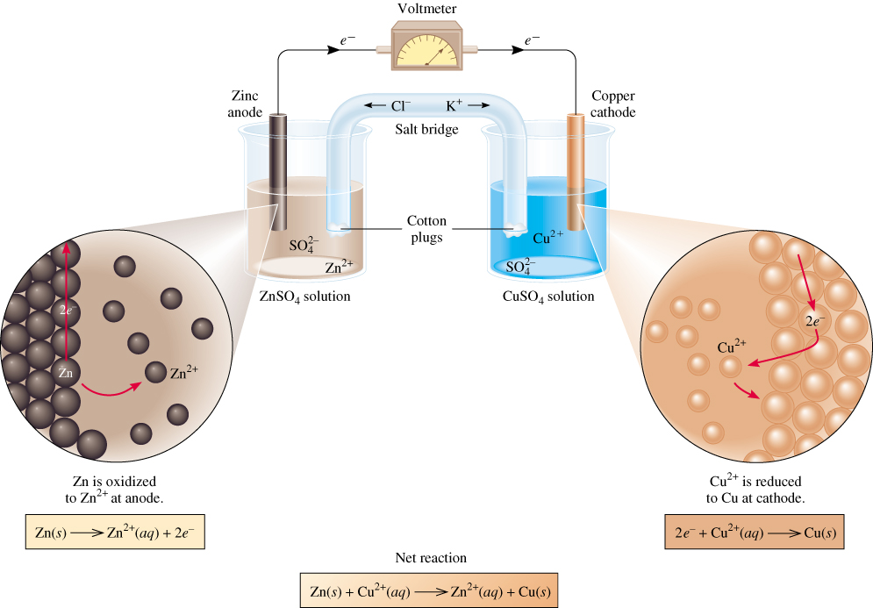
Galvanic Cells
anode
oxidation
cathode
reduction
-
+
spontaneous
redox reaction

Slide 20
Representation of cell reaction
Zn (s) | Zn²⁺ (1 M) || Cu²⁺ (1 M) | Cu (s)
anode cathode

Slide 21
Salt Bridge
Device used to connect the oxidation and reduction half-cells of a galvanic cell.
Allows the flow of ions to maintain a balance in charge between the oxidation and reduction vessels while keeping the contents of each separate.
Types: Glass tube bridges
Filter paper bridges
Filled with inert electrolyte.

Slide 22
Representation of single electrodes
Non metal electrodes
SHE or NHE : Pt|H₂(g, 1 bar)|H⁺(a = 1) ||
Chlorine electrode : Pt|Cl₂(g, 1 bar)|Cl⁻(M) ||
Metal electrodes
Copper electrode : Cu(s)|Cu²⁺(1 M)||
Zinc electrode : Zn(s)|Zn²⁺(1 M)||

Slide 23
Single Electrode Potential
The ability of an electrode to lose or gain electrons when it is in contact with its own ions in solution.
Oxidation Potential: Ability to lose the electrons.
Reduction Potential: Ability to gain the electrons.

Slide 24
Standard Electrode Potential
Potential of electrode during reaction under standard condition (when all solutes are 1 M and all gases are at 1 atm & 25⁰C).
Standard reduction potential
Standard oxidation potential

Slide 25
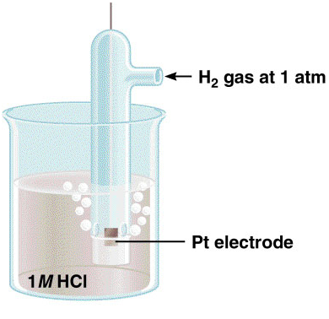
Determination of electrode potential
W.r.t. Standard Hydrogen Electrode.
2e⁻ + 2H⁺ (1 M) H₂ (1 atm)
E⁰ = 0 V
H₂ (1 atm) → 2e⁻ + 2H⁺ (1 M)
E⁰ = 0 V

Slide 26
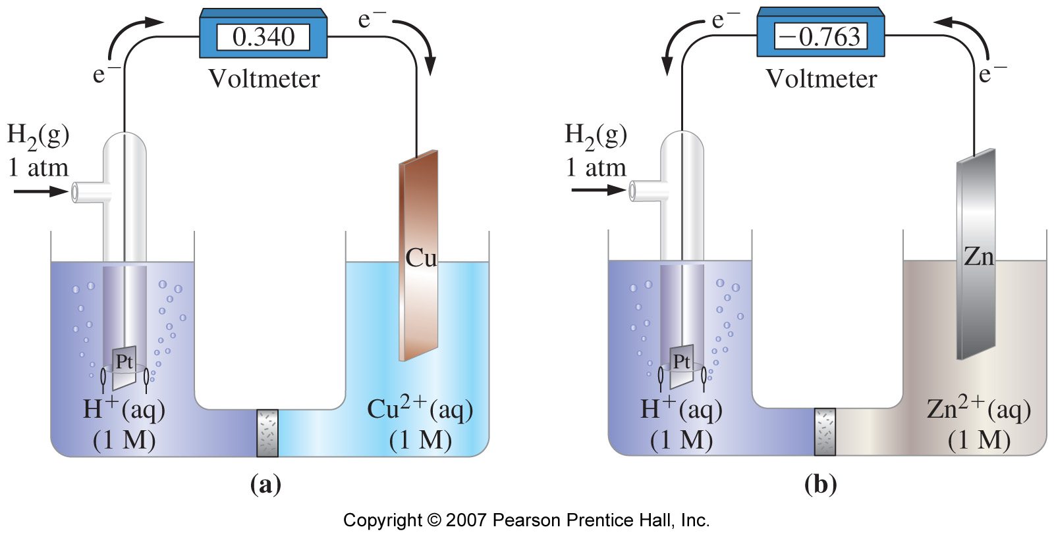
Examples
anode
cathode
cathode
anode

Slide 27
EMF (Electromotive force)
Driving force responsible for the flow of electrons from anode to cathode through the circuit.
E⁰ = E⁰_{cathode} - E⁰_{anode}
E⁰_{cathode}: Reduction potential of electrode undergoing reduction
E⁰_{anode}: Reduction potential of electrode undergoing oxidation

Slide 28
Applications of EMF measurement
Indicates about the feasibility of reaction.
Determination of valency of ions in doubtful cases.
Determination of solubility product.

Slide 29
Applications of EMF measurements
Determination of activity coefficients of electrolytes
Determination of Transport number of ions
Determination of Valency of ions in doubtful cases
Determination of solubility product

Slide 30
Nernst Equation
Correlation between the cell EMF to a standard value E⁰ and the activities of the species taking part in the cell reaction.

Slide 31
Basic form
For, M^{n+} + ne⁻ → M
At R = 8.313J; F = 96500C; T = 298K,

Slide 32
For complete cell reaction
Zn + Cu⁺² → Zn⁺² + Cu
Zn׀ Zn⁺² (c₁)׀׀ Cu⁺² (c₂)׀ Cu

Slide 33
Problem
Calculate EMF of the cell, Zn ׀ Zn⁺² (0.001M) ׀׀ Ag⁺ (0.01M) ׀ Ag Given, standard potentials of Ag/Ag⁺ and Zn/Zn⁺² are -0.80V and +0.76V, respectively.
Also calculate the equilibrium constant.
Answer: 1.58V & 1x10⁵²

Slide 34
ECS (Electrochemical Series)
Arrangement of elements in increasing or decreasing order of standard reduction potentials.
Equilibrium | E⁰ (volts)
Li⁺ (aq) + e⁻ Li (s) | -3.03
K⁺ (aq) + e⁻ K (s) | -2.92
Ca⁺² (aq) + 2e⁻ Ca (s) | -2.87
Na⁺ (aq) + e⁻ Na (s) | -2.71
Mg⁺² (aq) + 2e⁻ Mg (s) | -2.37
Al⁺³ (aq) + 3e⁻ Al (s) | -1.66
Zn⁺² (aq) + 2e⁻ Zn (s) | -0.76

Slide 35
Equilibrium | E⁰ (volts)
Fe⁺² (aq) + 2e⁻ Fe (s) | -0.44
Pb⁺² (aq) + 2e⁻ Pb (s) | -0.13
2H⁺ (aq) + 2e⁻ H₂ (s) | 0
Cu⁺² (aq) + 2e⁻ Cu (s) | +0.34
Fe⁺³ (aq) + e⁻ Fe⁺² (s) | +0.77
Ag⁺ (aq) + e⁻ Ag (s) | +0.80
Cl₂ (g) + 2e⁻ 2Cl⁻ (aq) | +1.36
Au⁺³ (aq) + 3e⁻ Au(s) | +1.50

Slide 36
Applications of ECS
Prediction of oxidizing or reducing ability.
Calculating cell EMF.
Determination of solubility of sparingly soluble salts.
Predicting feasibility of reaction.
Possibility of displacement of one metal by other from its solution.
Possibility of displacement of hydrogen by metal from solution.

Slide 37
Instrumental analysis
Conductometric titrations
Learning points
SA Vs. SB
SA Vs. WB
WA Vs. SB

Slide 38
HCl + NaOH Na⁺Cl⁻ + H₂0
Consider an acid base reaction
HCl Base
N1 = ? N2 = Given
V1 = 20ml(say) V2 = from graph
N1V1 = N2V2
N1 ca be evaluated

Slide 39
Strong acid vs. strong base
HCl + NaOH Na⁺Cl⁻ + H₂0
λ
End point?
Vol. of base

Slide 40
Strong acid vs. weak base
HCl + NH₄OH NH₄⁺Cl⁻ + H₂0
λ
End point?
Vol. of base

Slide 41
Weak acid vs. strong base
CH₃COOH + NaOH CH₃COO⁻ Na⁺ + H₂0
λ
Vol. of base

Slide 42
Mixture of two acids vs. strong base
HCl + CH₃COOH + NaOH CH₃COO⁻ Na⁺ + NaCl + H₂0
NaOH
CH₃COOH
λ
HCl
Vol. of base

Slide 43
Mixture of two acids vs. strong base
HCl + CH₃COOH + NaOH CH₃COO⁻ Na⁺ + NaCl + H₂0
NaOH
CH₃COOH
λ
HCl
Vol. of base

Slide 44


